Slide 1
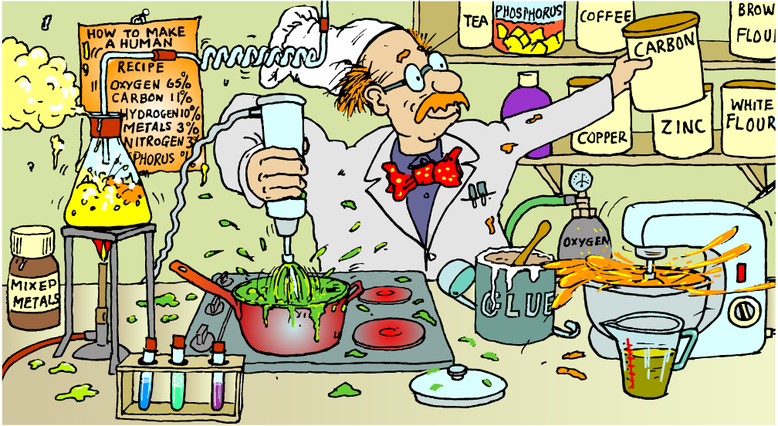
Elements, Compounds and Mixtures
Unit 1, Lesson 3

Slide 2
Starter: element names (page 11)
Element names and symbols
1) 6)
2) 7)
3) 8)
4) 9)
5) 10)
C
H
Au
S
O
carbon
hydrogen
gold
sulfur
oxygen
Nitrogen
Potassium
Helium
Aluminium
Magnesium
N
K
He
Al
Mg

Slide 3
Today’s Aim
Unit 1
Lesson 3
By the end of this lesson I will be able to identify elements, compounds and mixtures from particle diagrams

Slide 4




All substances are made of atoms
All substances are made of tiny particles called atoms.
Many substances are made up of different types of atoms.
hydrogen and oxygen atoms
carbon and hydrogen atoms
iron, aluminium, silicon, oxygen and boron atoms
carbon, nitrogen, hydrogen, oxygen and sulfur atoms

Slide 5
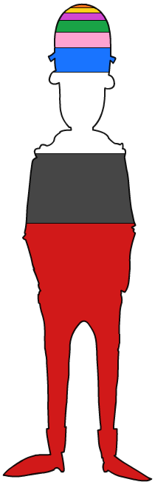










Atoms make up everything in the universe, including you!
Atoms are the smallest part of an element. Different elements join together in different ways to make all the materials in the Universe, from rocks to air.
others (0.4%)
sulfur (0.25%)
potassium (0.35%)
phosphorus (1%)
calcium (2%)
nitrogen (3%)
Just like all materials in the Universe, humans are also made of atoms.
hydrogen (10%)
carbon (18%)
oxygen (65%)

Slide 6
What is an element?
An element is a substance made up of only one type of atom.
For example, hydrogen exists as two hydrogen atoms joined together, the formula is H₂.
Elements cannot be chemically decomposed into simpler substances.
An atom is the smallest particle of an element that can take part in chemical reactions.

Slide 7
Element Samples
Your teacher may show you some examples of elements.
Do not open the tubes, simply have a look at the diversity of different elements.
Is there anything in common? What are the major differences? How many elements are there in the universe?

Slide 8
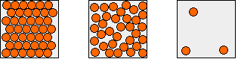
Your Task
Use colours for atoms. Draw 3 different particle diagrams to show:
A solid element
A liquid element
A gas element

Slide 9
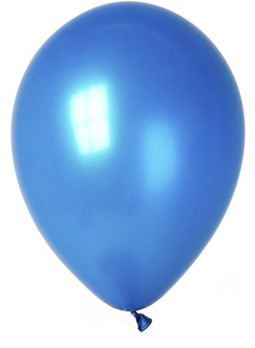
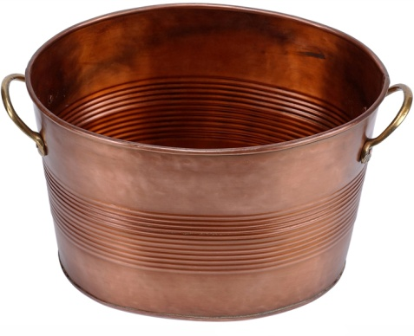
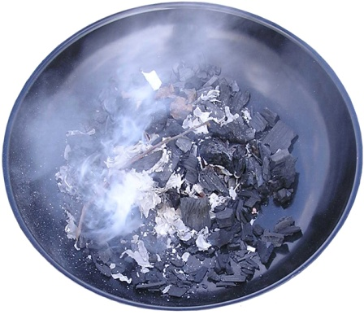
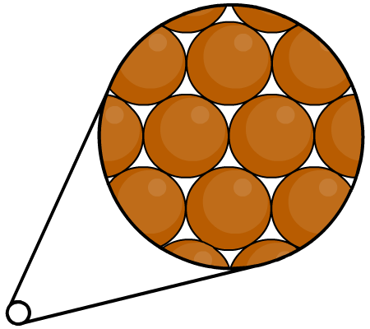
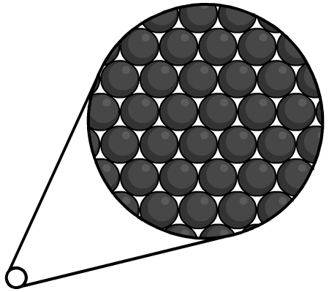
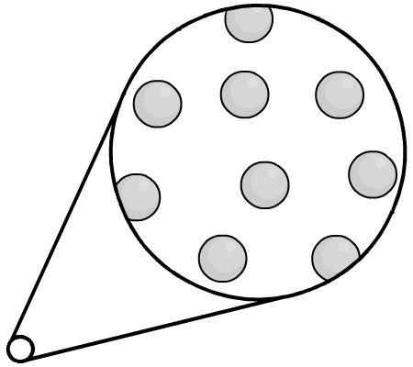
Elements
Copper is an element made up of copper atoms only.
Carbon is an element made up of carbon atoms only.
Helium is an element made up of helium atoms only.

Slide 10
What is a compound?
A compound is a substance formed from two or more elements chemically joined (bonded) together in fixed proportions.
A compound has a definite chemical composition and hence specific formula.
For example, a water molecule contains two hydrogen atoms bonded to one oxygen atom, so the formula is H₂O.
A compound has chemical properties different from the properties of the elements it contains.

Slide 11
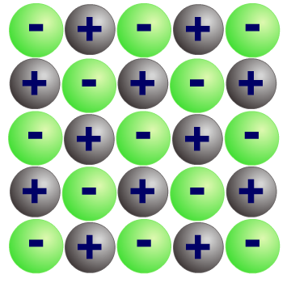
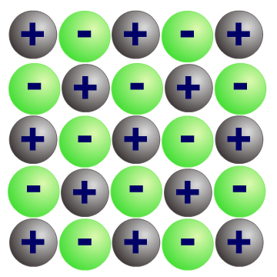
Some common compounds
methane CH₄
H
O
O
C
O
C
H
H
H
H
H
carbon dioxide
CO₂
water H₂O
sulfur dioxide SO₂
ammonia NH₃
S
O
O
N
H
H
H
Sulphuric acid, H₂SO₄
sodium chloride NaCl

Slide 12
What is a molecule?
A molecule is made up of a few* atoms chemically bonded together.
Molecules can be formed by two atoms of the same element or by atoms from two or more different elements.
e.g. oxygen is an element made up of oxygen atoms only:
e.g. water is a compound made up of two elements chemically combined:
O
O
O
H
H
an oxygen molecule O₂
a water molecule H₂O
Notes:
*few is a difficult word to define. Basically in chemistry it means a small number, e.g. 2 or 3, or maybe even 50 or 60. These are very small numbers compared to millions and billions!

Slide 13
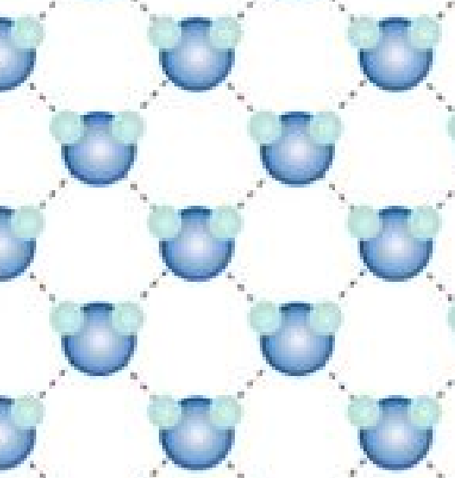
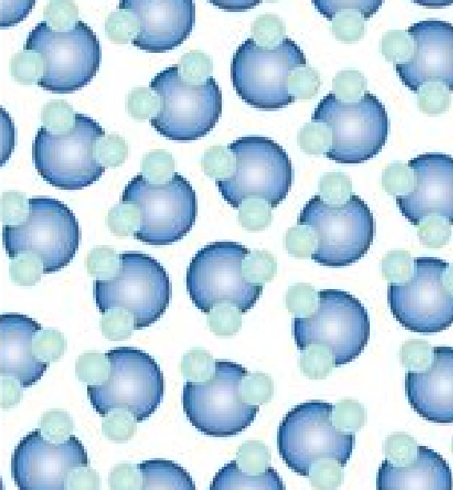
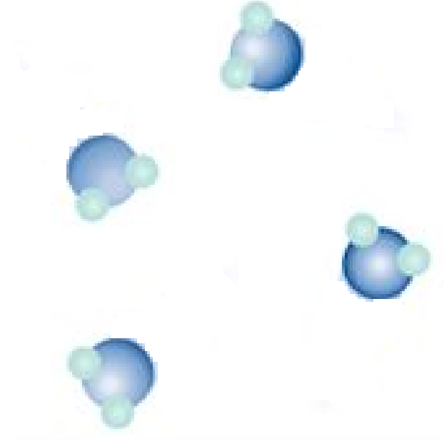
Your Task (top of page 12)
Use colours for atoms. Draw 3 different particle diagrams of H₂O in each state of matter:
ice
(a solid compound)
water
(a liquid compound)
steam
(a gas compound)

Slide 14
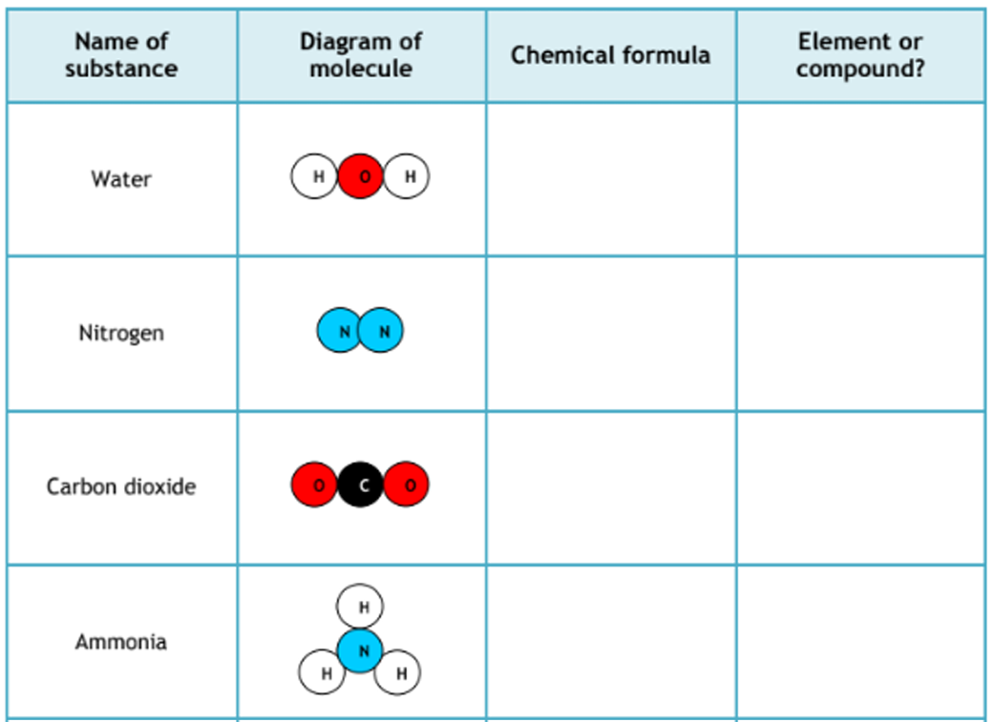
Fill in the blanks on page 12

Slide 15
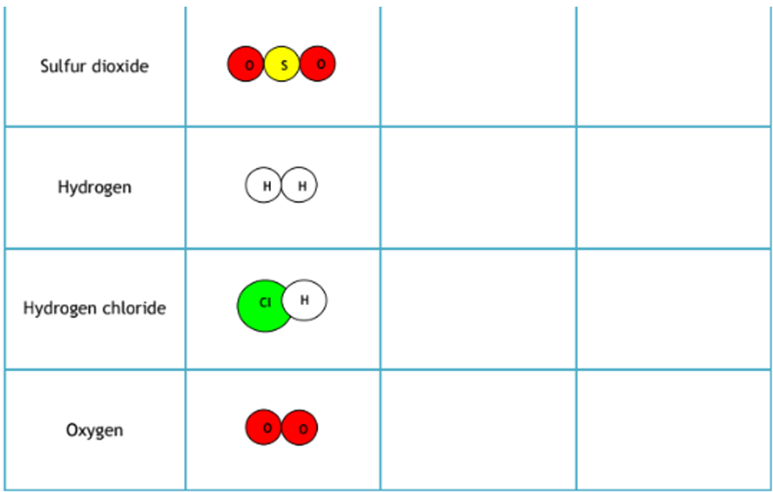
Fill in the blanks on page 12

Slide 16

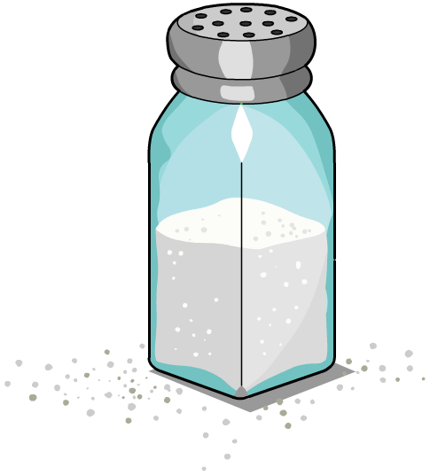
What is a mixture?
A mixture contains two or more substances that are mixed together, but have not chemically bonded with each other.
For example, seawater is a mixture of water, salt and other substances.
By definition, mixtures are impure as they contain a number of different substances. For example, air is a mixture of oxygen, nitrogen and small amounts of carbon dioxide.

Slide 17
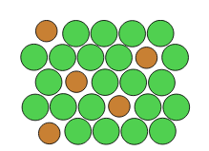
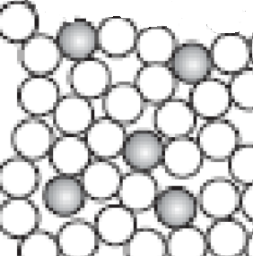
Your Task
Use colours for atoms. Draw 3 different particle diagrams to show:
A solid mixture
(e.g. metal alloy)
A liquid mixture
(e.g. a solution)
A gas mixture
(e.g. the air)

Slide 18
Pure and Impure
Mixtures are impure - one part of the mixture may be different to another because the components of the mixture are not bonded to each other in a regular arrangement.
Every atom in an Element is the same. This is certainly pure. And since every part is the same the element always has the same physical properties. So pure gold in Japan melts at the same temperature as pure gold in the Algarve.
Compounds are also pure. Pure water is H₂O. Every molecule is the same. So pure Ice in Japan melts at 0ºC just like it does in Lisbon.

Slide 19
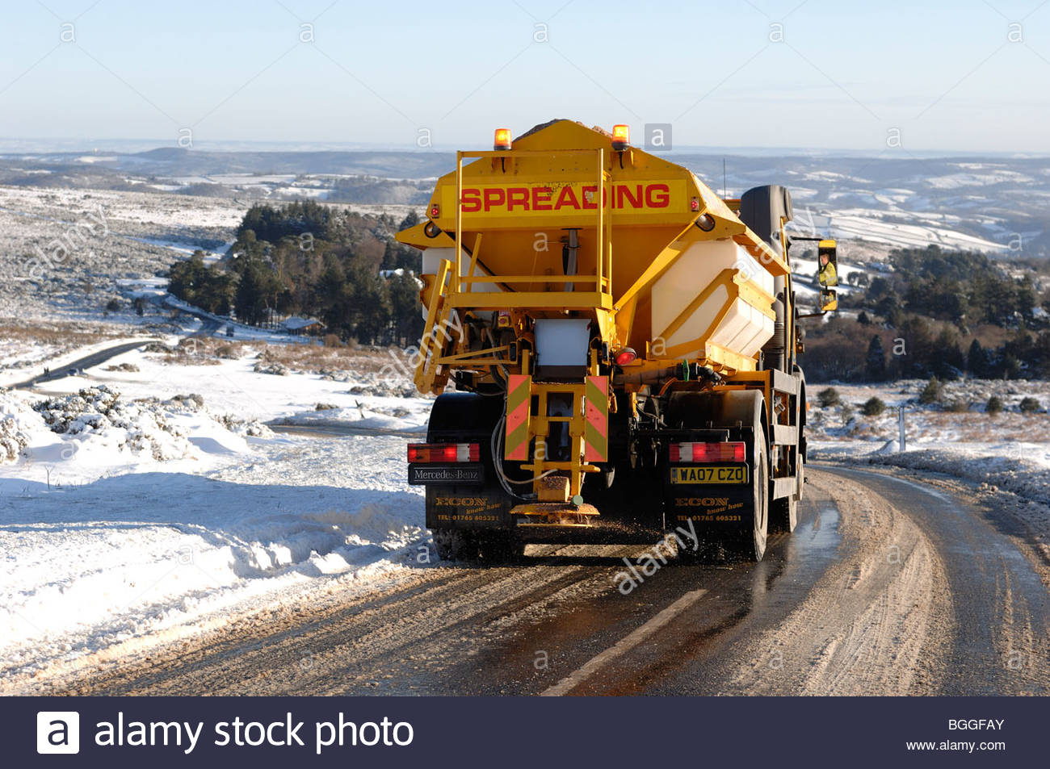
Gritting Lorry / Salt spreading

Slide 20
Pure and Impure
One way to check that a substance is pure is to melt a small sample and show that all of it melts at the same temperature. If it is pure it will have a fixed melting point.
And one way to show that a substance is an impure mixture is to melt a sample and show that parts of it melt at one temperature and parts at another. Impure substances will melt over a range of temperatures.

Slide 21
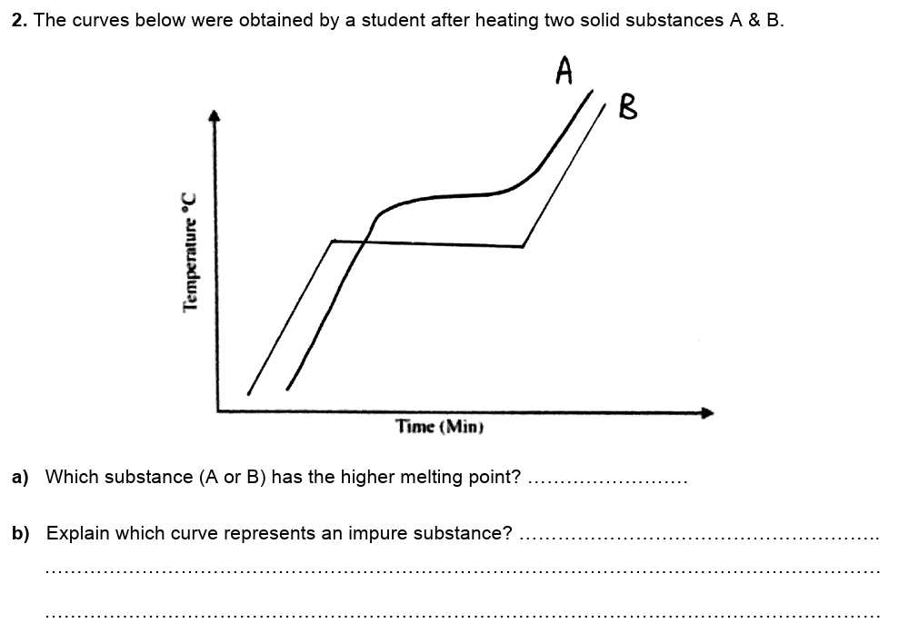
Pure vs Impure (page 14)
A
The impure substance is A because it changes state over a range of temperatures. Pure substances change state at a fixed temperature.

Slide 22
Element, compound or mixture? Pure or impure?

Slide 23
Element, compound or mixture? Pure or impure?

Slide 24
Element, compound or mixture? Pure or impure?

Slide 25
Element, compound or mixture? Pure or impure?

Slide 26
Element, compound or mixture? Pure or impure?

Slide 27
Element, compound or mixture? Pure or impure?

Slide 28
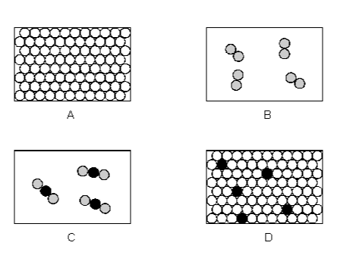
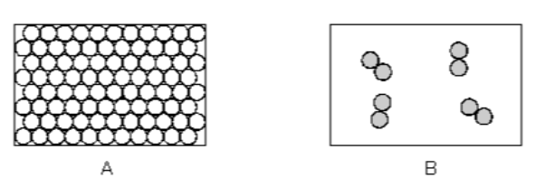
Label A, B C and D with one word from each yellow box (3 words in total)
element compound mixture
solid liquid gas
pure impure

Slide 29
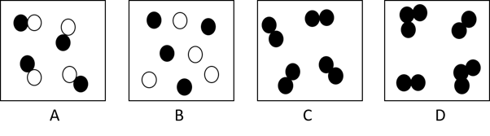
Final question!
Which of the diagrams above represent more than one substance?
A, B and D
B only
A, C and D
B and D

Slide 30
What you need to know
Unit 1
Lesson 3
Syllabus Content
1.8 understand how to classify a substance as an element, compound or mixture
1.9 understand that a pure substance has a fixed melting and boiling point, but that a mixture may melt or boil over a range of temperatures
1.14 know what is meant by the terms atom and molecule
My Learning

Slide 31
Homework
11 September 2014
11 September 2014
Cut up six cards:
You should then use coloured pens/pencils to draw six different particle diagrams:
diatomic gaseous element (O₂)
solid element (Au)
liquid water (H₂O)
steam (H₂O)
solid compound (table salt, NaCl)
mixture of an element (O₂) and compound (CO₂)
Write the words on one side and draw the particle diagram on the other side.

